Slide 1
Java class eco system
Module 5

Slide 2
Content
OOP
Class and Objects
Constructors
Methods
Parameters by value / by reference
Encapsulation
Anonymous objects
Short intro in exceptions
Lambda function
Facts about the quiz

Slide 3
OOP
OOP - Object-oriented programming
OOP is about creating objects containing both
Data / these are the class fields
Methods / the behavioural of the class
OOP provides structured and reusable source code

Slide 4
Class and Objects
Class
Template representation of an object (Car, House, City, Animal ….)
Defines the characteristics and the behavioral for
Data: The car has number of doors, number of windows, color, engine and etc ..
Behavioral: The car can move
Object
Bundle of data and it’s behavioral
Class | Objects/Instances
CarMaker | Volvo, Tesla, NIO, Audi …..
City | London, Sofia, Tbilisi …
Employee | George, Michael, Lili …

Slide 5
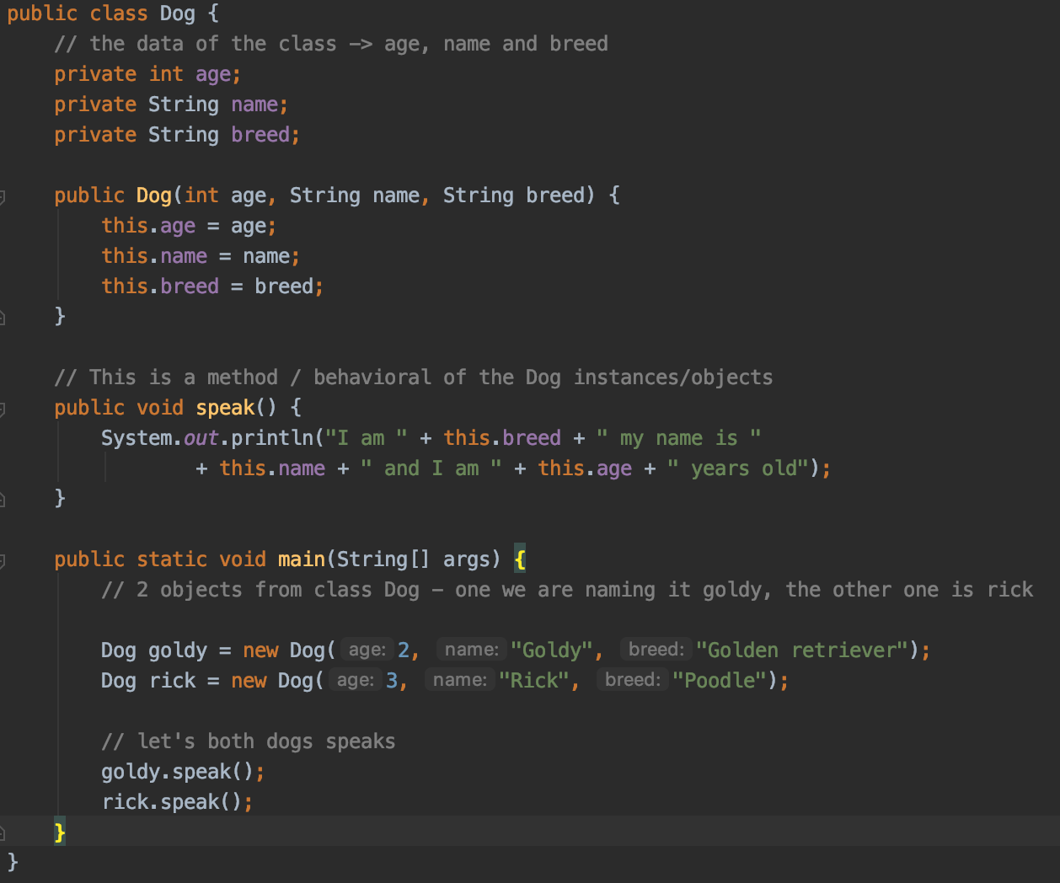
Class and Objects
I am Golden retriever my name is Goldy and I am 2 years old
I am Poodle my name is Rick and I am 3 years old

Slide 6
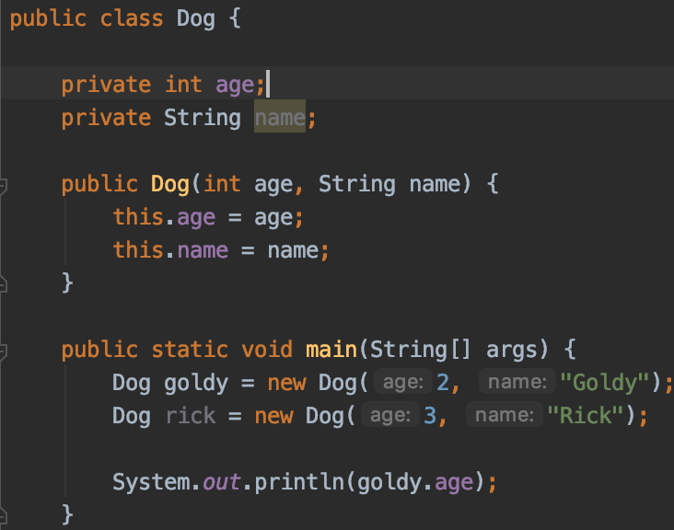
Constructors
Initializes the object when it is created
Gives initial value to the class based variables
A method with No return type and with name matches name of the class
Objects are being created via the keyword new which allocates a new memory in the java heap
There are 2 types of constructors
No argument constructors (the default one)
Parametrized constructors (passing variables)

Slide 7
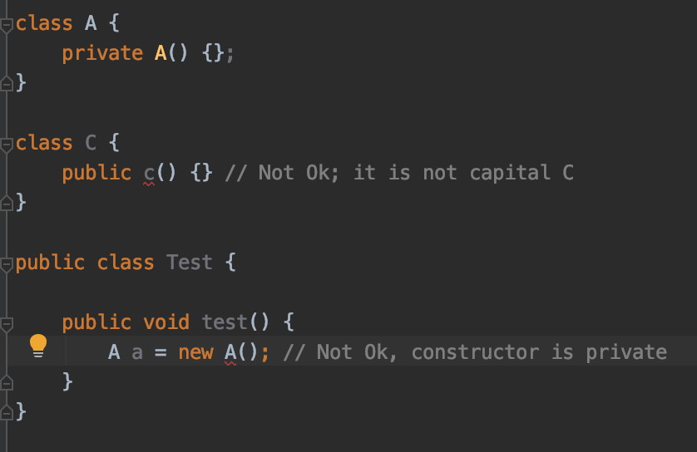
Constructors

Slide 8
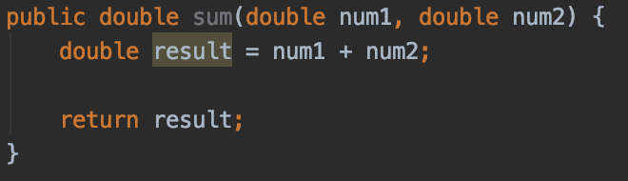
Methods
Block of code with statements in it
Execute logic, number of actions, known as function / method
Void return type means the method does not return value/result
Syntax
modifier final returnType methodName (comma separated parameter) throws Exception {
method body
return the method result
}

Slide 9
Methods
public final void hello(String v) throws Exception { }
Element | Example | Required?
Access modifier | public | No
Optional specifier | Final, static, final | No
Return type | void | Yes
Method name | hello | Yes
Argument list | String v | Yes, but can be empty parameters
Exception list | Throws exception | No
Method body | {} | Yes, but can beepty body

Slide 10
Methods
void hello() // Ok
void public hello() // Not Ok – first public element, then return type
void hello4() // Ok – identifiers allow digits / but not to start with digits
default hello() // Not ok – there is no default keywork
public void final hello() // Not ok – final should be before return type

Slide 11
Methods
Return type
An actual java type (int, String and etc … ) or void, if does not return nothing
Methods with return type other than void; should have a return statement
int m(String v) { if (v!= null) return 1; } // Not Ok, there is a chance to not return anything if v is null
Methods returning void could have return statements (return;)
When returning a value, it needs to be assignable to the return type
int m() { return 8; } // OK
int m() { return 6l; } // Not Ok;

Slide 12
Methods
Parameters list
Required
Could be empty
For multiple parameters, separation via comma ,
Examples:
public void hello() {} // Ok
public void hello {} // Not Ok, no parameter list
public void hello (int a; int b) // not Ok, no ;
Method name
an identifier -> means letters, $, _, digits (but not at start)
Reserved words are not allowed
Examples
void hello() {}
void hello_$() {}
public void() {} // Not Ok, no name provided

Slide 13
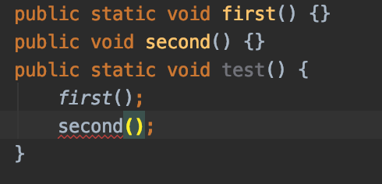
Methods
Static methods
Could be called without instance creating
They belongs to the class / referred by the class itself, no instance required
Can NOT be overridden
Object/instance based methods
Requires object/instance in order to be called
Belongs to an object of a class, NOT to the class itself
They can be called AFTER creating an instance of the class
They can be overridden
They are resolved dynamically / run time
Error on second() ->

Slide 14
Methods
Static vs. instance
Type | Calling | Legal? | How?
Static method | Another static method or static variable | Yes | Using classname
Static method | An instance method or instance variable | No
Instance method | Static method and static variable | Yes | Using class name or instance reference
Instance method | Instance method and instance variable | Yes | Instance reference

Slide 15
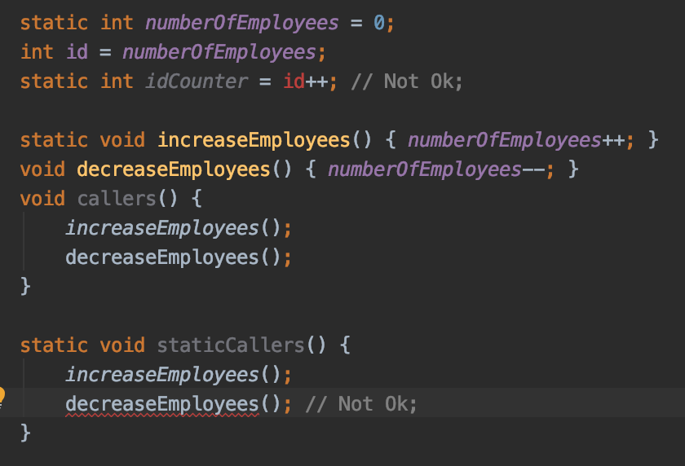
Methods
Static vs instance
Static idCounter trys to access instance variable, which leads to compilation error
Static method staticCallers tries to call instance method which leads to compilation error

Slide 16
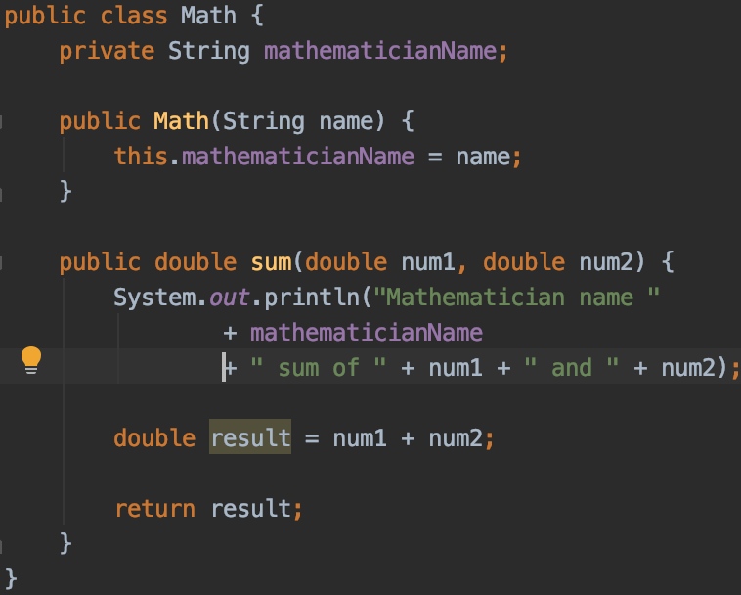
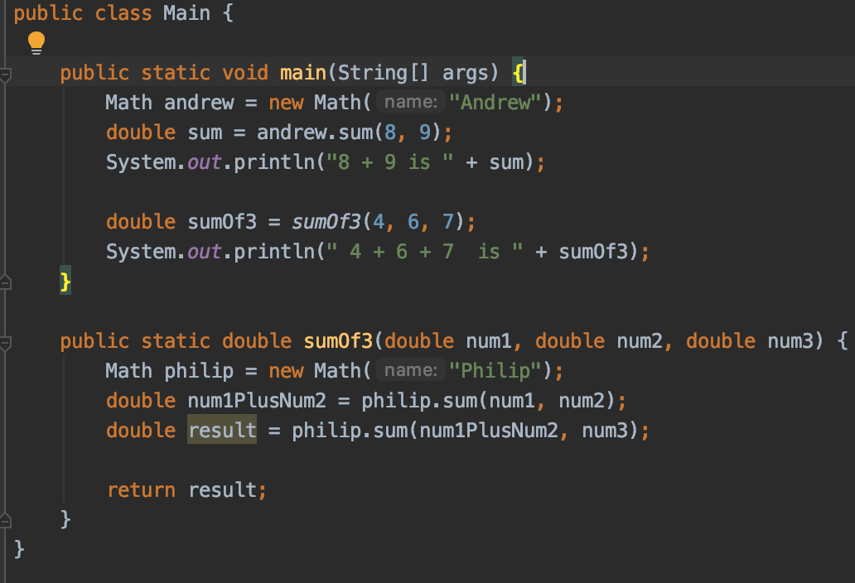
Methods and objects example
Mathematician name here is Andrew
Calling sum3( …) without an object
Mathematician name here is Philip

Slide 17
Methods
Demo -> java_class_eco_system_demos -> Math & Dog

Slide 18
Parameters by value / by reference
In java the method parameters are passed by value
Means a copy of the parameter is being passed to the method
After method execution the argument’s value remain same. Means It does not changed outside the method if it has been changed insight it
Object parameters are references to the real objects in the memory heap
Means the object references is passed by value (but referring to the same memory in java heap)
If an object state of the parameter changed in the method, then outside the method is also changed

Slide 19
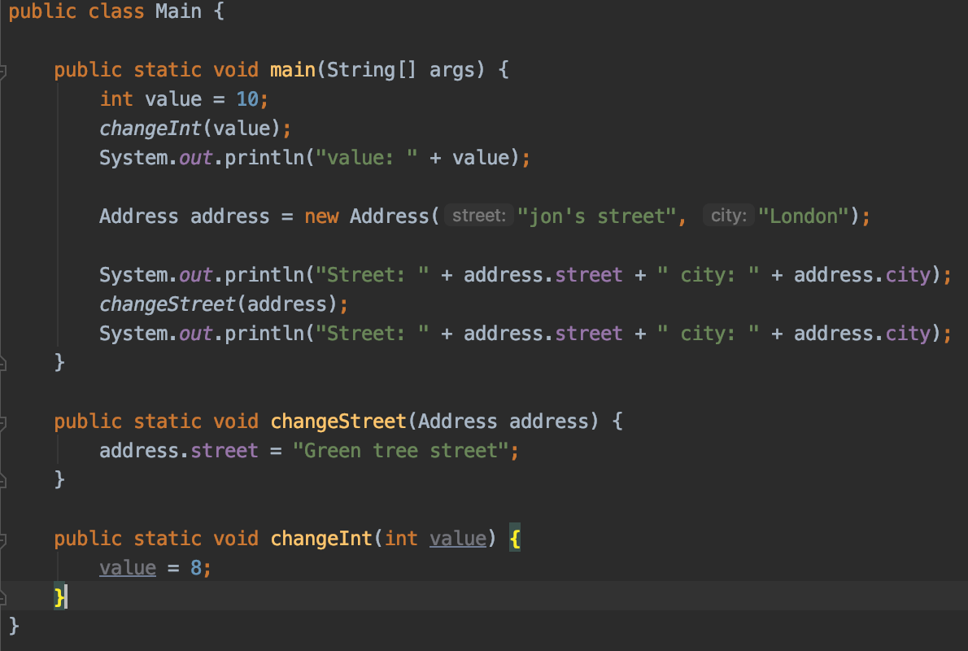
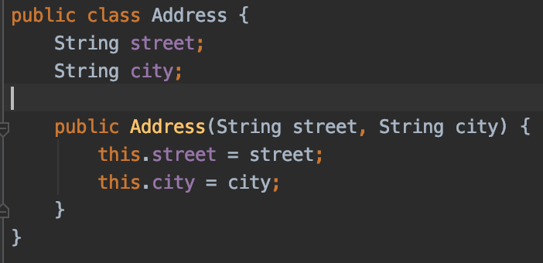
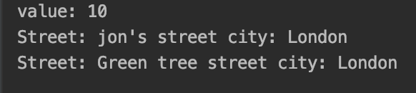
Parameters by value / by reference
The value of the primitive parameter is NOT changed
The state of the object is changed

Slide 20




Parameters by value / by reference
main(…)
Java Heap
address
street
city
changeStreet(…)

Slide 21
Parameters by value / by reference
All members of a method dies and if some objects were created inside it then these objects becomes unreachable or anonymous after method execution and thus becomes eligible for garbage collection
e.g.
class Test {
static void show() {
Test t = new Test();
}// t the end of this method the instance t is eligible for Garbage Collection
}

Slide 22
Parameters by value / by reference
Demo -> java_class_eco_system_demos -> methods -> home

Slide 23
Encapsulation
Wrapping the data (variables) and logic (methods) together as a single unit
Variables are hidden from any other classes and they are accessible via methods
Achieved via declaring the variables as private and accessing them via public methods
All class variables are private and we do have getters/setters for all of them
One of the 4 main characteristics of OOP (the other 3 are polymorphism, inheritance and abstraction)

Slide 24
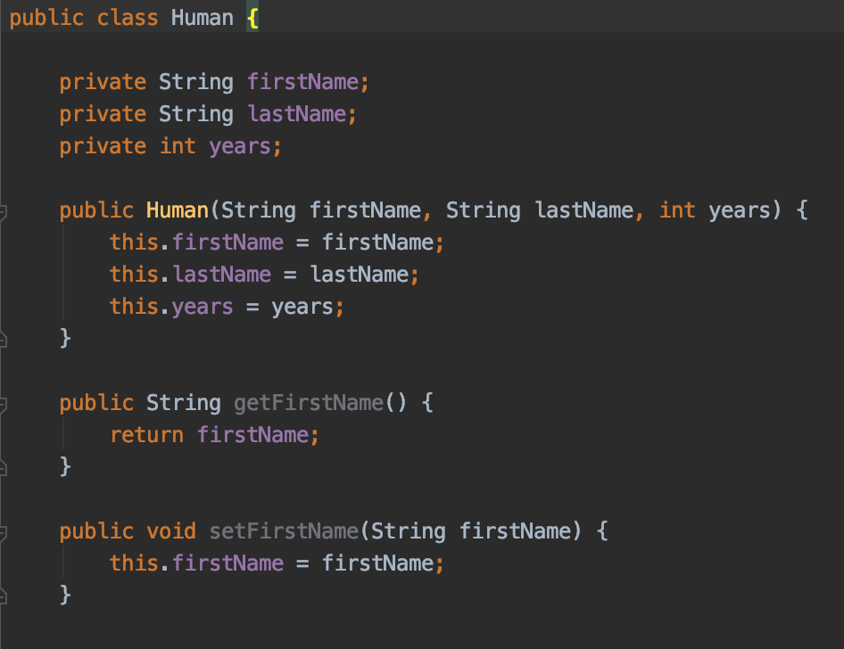
Encapsulation
Hiding firstName, lastName and years from outside via usage of private
Adding public methods for
accessing the private data

Slide 25
Encapsulation
Why encapsulation
Hiding the class related data from outside (other classes) unappropriated usage
Changing the state of the class depends only n the rules insight the class
The class has total control of what is happening within these fields
Better reusable source code
Unit testing it
We could have immutable class or read only or write only sub set of fields of the class

Slide 26
Encapsulation
Demo -> java_class_eco_system_demos -> encapsulation

Slide 27
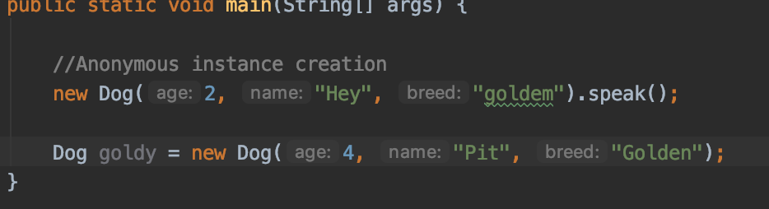
Anonymous objects
objects that are instantiated but are not stored in a reference variable
They are used for immediate method calling.
They will be destroyed after method calling.
They will be eligible for Garbage Collector immediately after the method is called

Slide 28
Short intro in exceptions
A problem that arises during the execution of a program
When an Exception occurs the normal flow of the program is disrupted
When an Exception occurs the program/Application terminates abnormally
Example of exceptions use cases:
File is not found when trying to open a file for reading
A user has enter an invalid number
A communication fail when trying to establish a connection
And many others

Slide 29
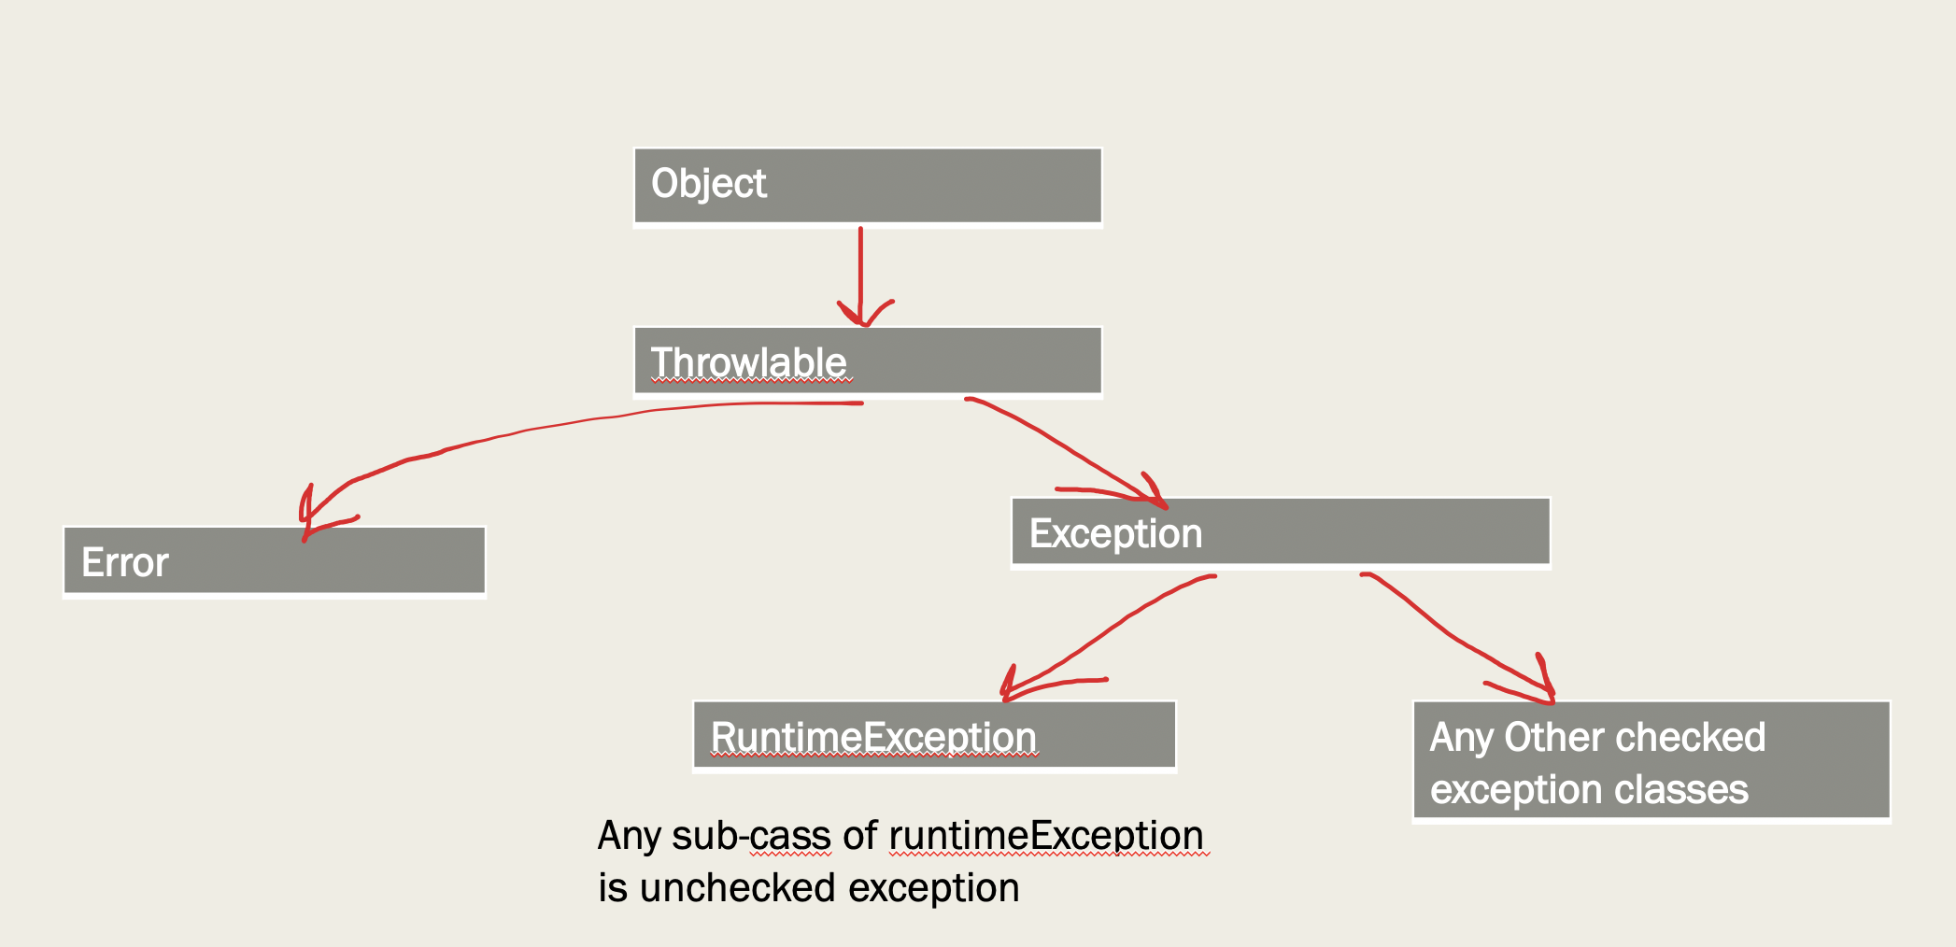
Short intro in exceptions

Slide 30
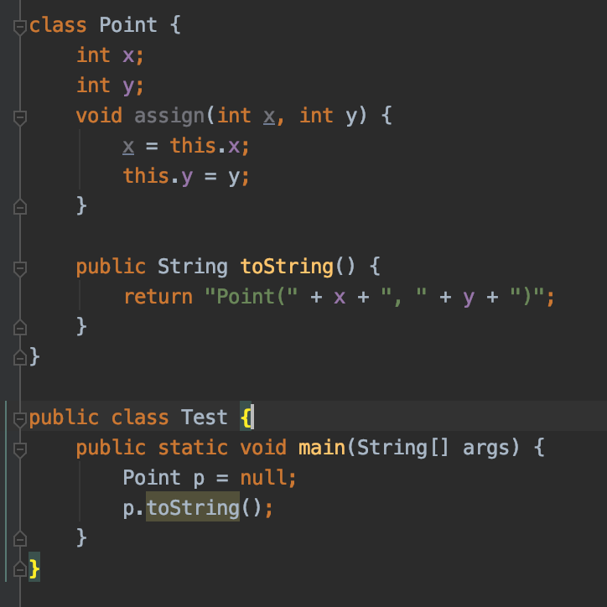

Short intro in exceptions

Slide 31
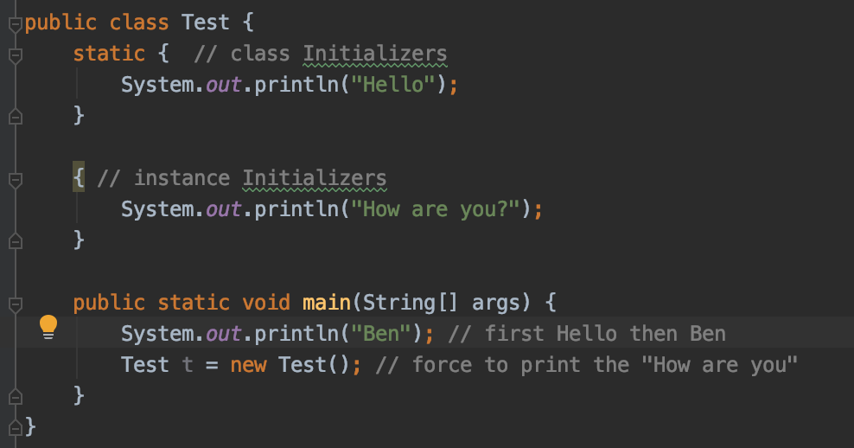
Facts about the quiz
Each .java source file can contain any number of default classes but can only have one public class
A Java class can only have public or default access specifier
protected class Human {} // is wrong
Class and Instance Initializers
The blocks outsite the methods and constructors
First static blocks are called

Slide 32
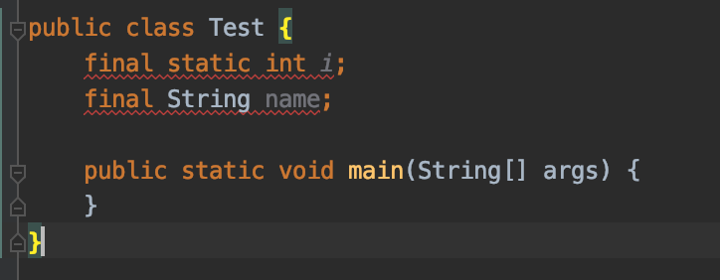
Facts about the quiz
final fields should be always initialized
For static at time or declaration
For instance based – at time of declaration or in the constructor

Slide 33
Facts about the quiz
If you create arg based constructor but you don’t write the no-arg constructor you can not create a class using the no-arg constructor
parameters to methods are passed by value – a copy of the parameter, means
when any variables of primitives types are passed as parameters to a method, their values will not change
When any variables of objects, then object state of the parameter changed in the method, then outside the method is also changed. But if change the reference to a new instance, then outside doesn’t have effect (as we do have a copy f reference passed to the method)

Slide 34
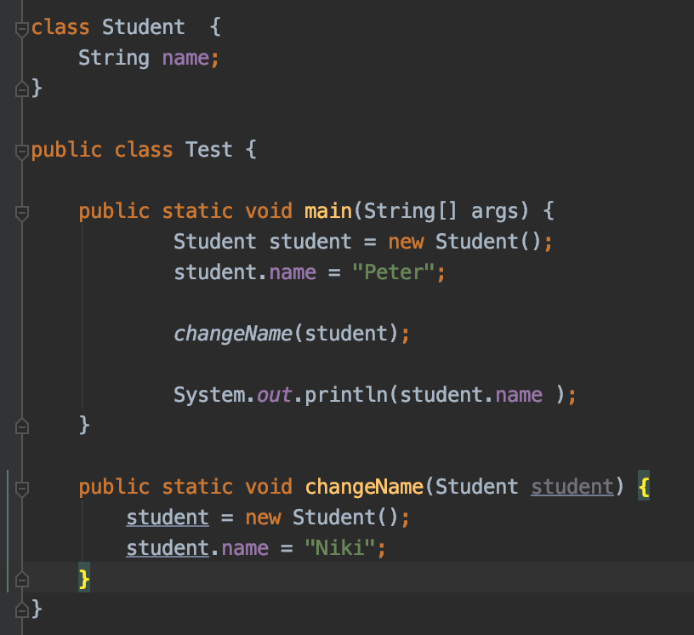
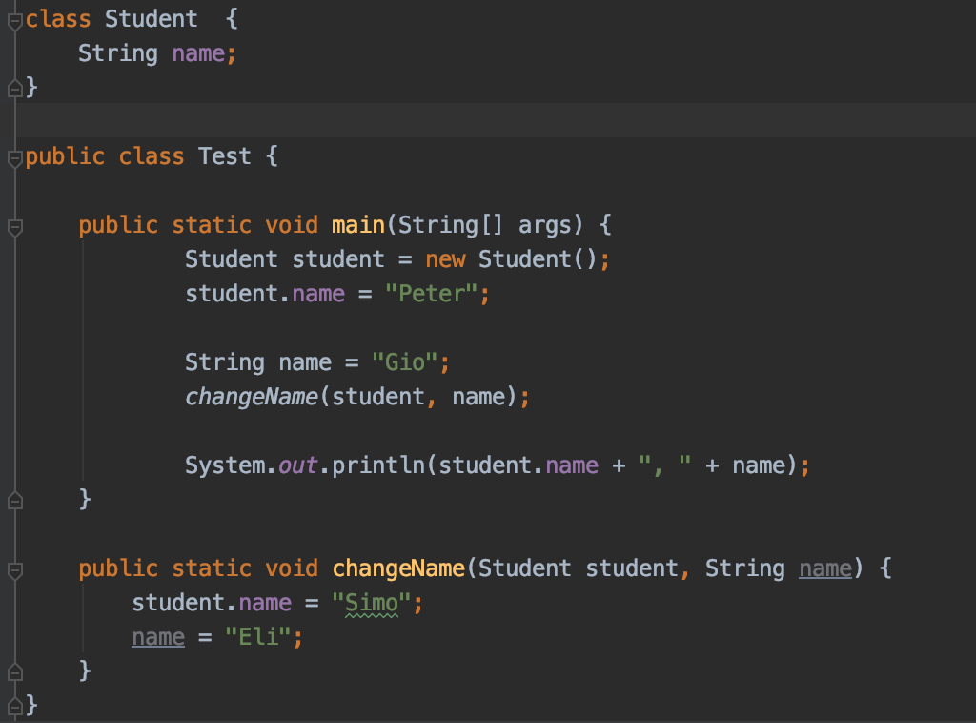
Facts about the quiz
The result is: Simo, Gio
The result is: Peter

Slide 35
Facts about the quiz
Constructor overloading means constructors can call each other, but that call should be always happened first
class Human {
public Human() {
System.out.println(“Hey Human”);
this(“Default”); //Not Ok, compilation error – this(“Default”) should be called first
}
public Human(String name) {
}
}

Slide 36
Facts about the quiz
Method parameters with final key words for them, can not be changed in the method
For primitive parameters, means we can not assign new value
For object parameters, means we can not assign to a new based instanced, but we can change state of the object parameter
Instances crated insight a methods are eligible for garbage collector after method execution
Return values for methods
When return type is a class, the object returned must be of the same class or a subclass of that class
When return type is an interface, the object returned must implement it
When return type is void, the method doesn’t return a value but it can contain return; statements for branching

Slide 37
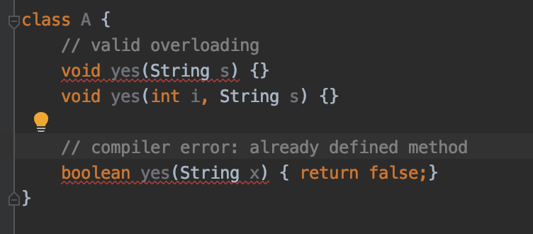
Facts about the quiz
Method overloading
Different methods with the same name whenever they have different parameter lists (type or order), means changing the signature:
Number of arguments
Type of arguments
Order of arguments if they are different types
The return type is not considered when differentiating methods

Slide 38
Facts about the quiz
Be able to identify correct and not correct method declaration
Recognize valid and not valid static imports usage
Right usage : import static
Make sure they are importing static members not instance members
Identify when method or field is accessible. Takes attention on
access modifier (private, public, protected, default)
Static and instances calls – e.g. static method can not call instance variables and methods

Slide 39
Facts about the quiz
Varargs
allows invoking a method with an arbitrary number of arguments (0 to n). The syntax is:
parameterType... parameterName
There can be only one parameter of this type per method and it’s always the last parameter
Inside the method the argument is always treated like an array
void foo(char c, int... i) { // always the last parameter System.out.println(i[0]); // inside is treated like an array } // calling the method as: object.foo(‘c’, 1, 2, 3); // invoking with N parameters object.foo(‘c’, new int[] {1, 2, 3}); // invoking with an array

Slide 40
Exercises

Slide 41
Questions?
Notes:
Do you have any questions?

Slide 42
Thank You For Your Time

